Slide 1

Jonathan Howe
Case Studies
Product Design Leader
jonathanhowe@outlook.com
linkedin.com/in/jonathanhoweux
Companion to the portfolio deck.

Slide 2
Journi
Bill inspection & pay

Slide 3
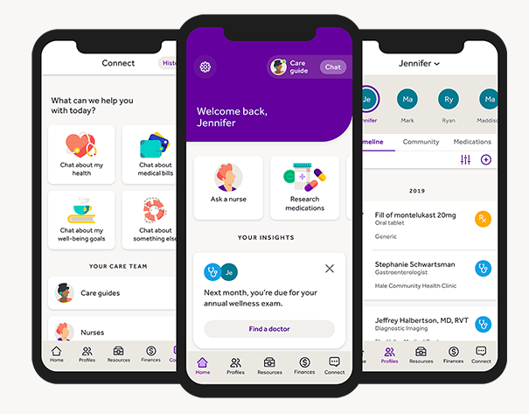
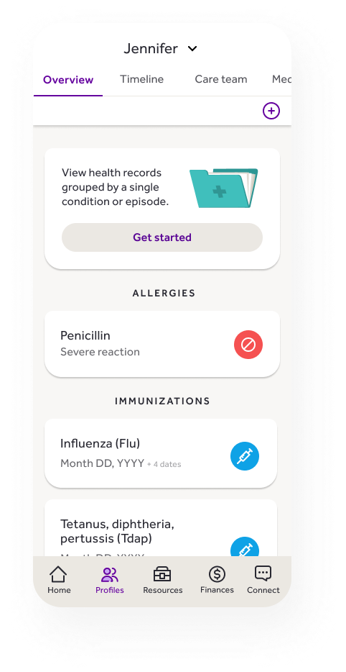
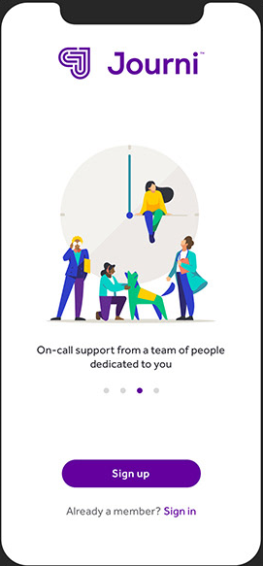
Notes:
Journi sold to employers, used by employees
Startup project inside of Cambia, who owns Regence Blue Cross Blue shield
List of health events, chat/call with human “care guides”, self-track medications, allergies, immunizations, and this became a COVID information hub.

Slide 4
Problem Statement
Health care consumers are often overpaying for their care
    Bills can be miscoded
    Double-billing can occur
    Consumers may be making financially harmful choices
    Paying bills can be a nuisance
How might we help users save money and time paying bills?
Notes:
Each doctor’s office seemed to have its own patient portal

Slide 5
Factors
Had existing AI training data from being part of a health insurer
    Commonality analysis of which bills were usually sent back
    Database of codes and combinations most likely to be erroneous
    Estimated average annual cost per person of errors (avg. ~$80/family/year)
Customers were intrigued
    In “Buy a feature” exercises, customer panels consistently ranked billing issues high
    One person per family typically handled all things health — the “Household CEO”
      When asked about their health journey, most related with personal stories, however…
      When asked what they wanted, most mentioned lower costs and time savings
      Customers lamented that each provider had a different patient portal
Notes:
Even those who used mychart at the time had different instances of mychart, passwords and login management were core complaints

Slide 6
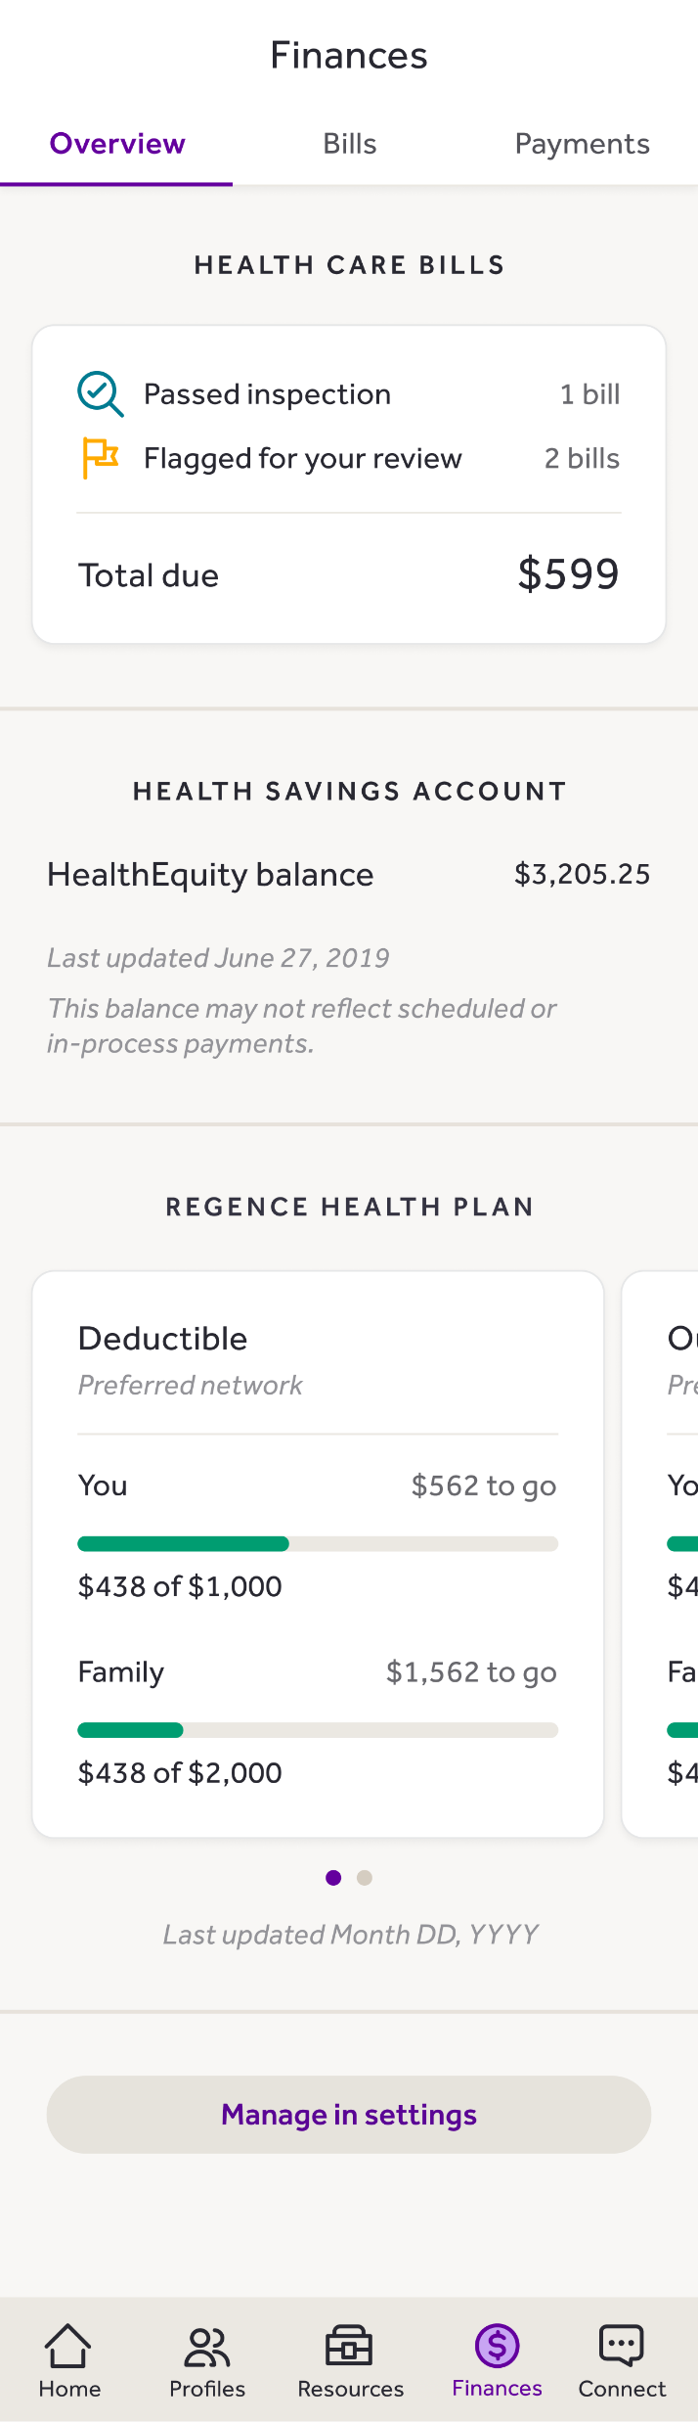
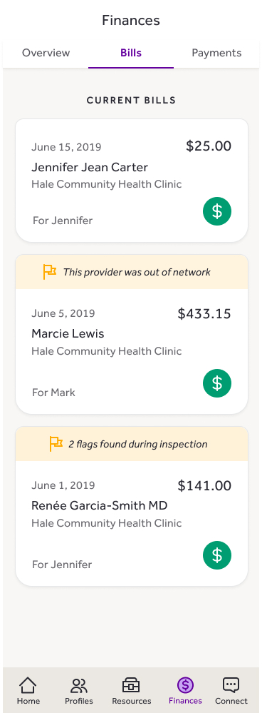
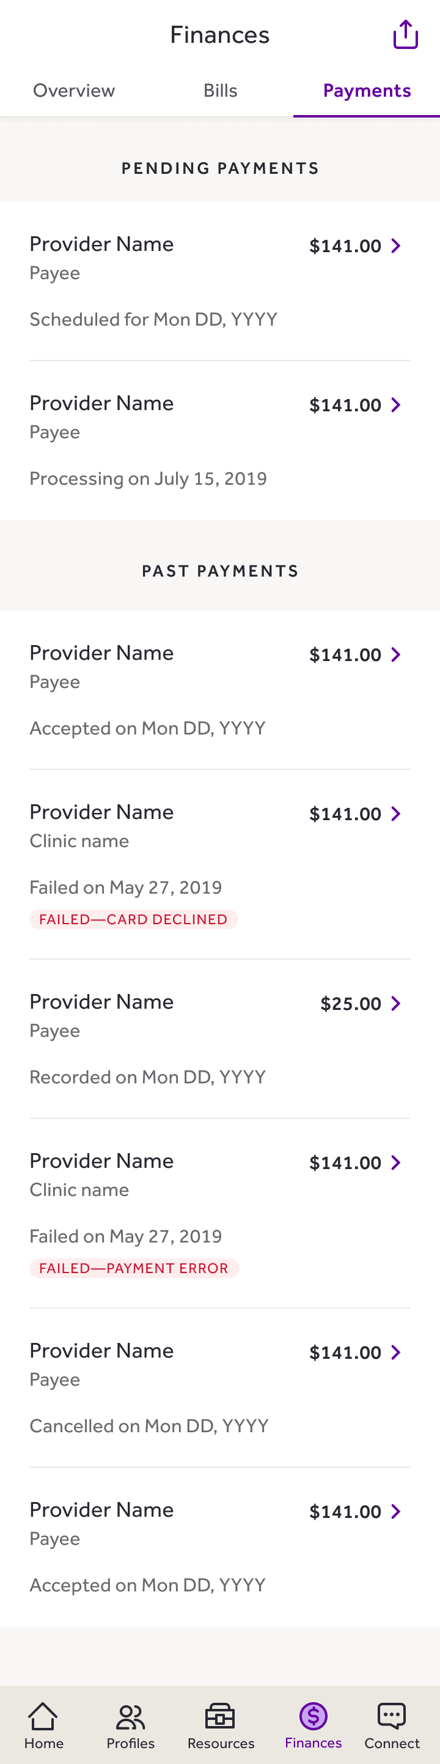

Slide 7
Challenge #1
How to convey potential issues
    Analysis was not 100% accurate.
    Didn’t want to unnecessarily alarm people or add stress
    Some states required explanation
Notes:
Some things “Look right” and aren’t, some might be wrong and user can’t go back in time
Named the issues “flags” and chose a non red color. Yellow conveying caution. Vs. real issues like card declined

Slide 8
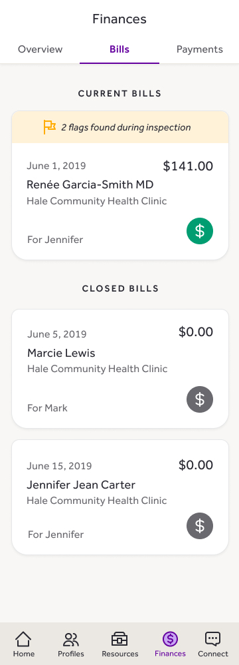
Challenge #2
Mix of self-paid and app-paid bills gave false issues
    Couldn’t require people to be fully “all in” on bill pay
    How could people be expected to mark bills they or a spouse paid?

Slide 9
Challenge #3
Some behind-the-scenes smoke and mirrors with the bill pay pilot
    Used EOB (Explanation of Benefits) instead of actual bills
    Bills needed manual verification, so the program wasn’t ready to scale
    Delays between user action and payments made
    The llama
Notes:
Developed special language for concept of a “closed” bill – no further user action required but not technically paid
Stuck with the concept of them being “bills” – core concept where we generally leaned towards comprehension over perfect accuracy.

Slide 10
Success Metrics
In the initial phases, it was all about usage
    Usage of application: Sessions per month, per week
    Usage of bill pay: Percentage of bills paid
    Usage of chat assistance
...and how that factored into contentment
    Net Promoter Score changes
    SUS Score changes
    User Satisfaction Surveys

Slide 11
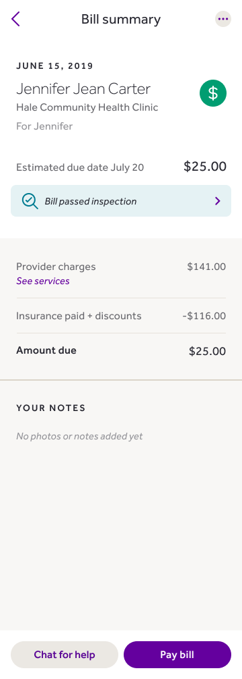
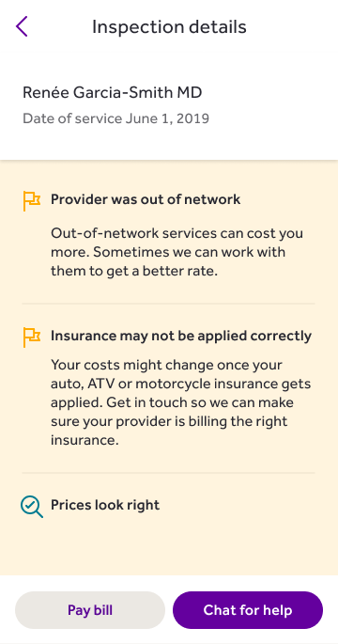

Slide 12
Results
We had a small subset of delighted, all-in users
    Analytics showed a lack of trust — users frequently returned to the payments page even without bills
    Those that paid one bill tended to pay all bills
    Bill mitigation team had a roughly 50% success rate in correcting flag bills once engaged via chat
Lesson: An app that replaces or introduces new habits needs daily reasons to engage
    Most people do not relish thinking about their health costs
    Even though Journi was “free,” few developed the habit or had the need to use it — average engagement was <2 uses a month.
    Fully-staffed customer engagement team formed before we even hit MVP
Notes:
Huge parallels with Post-Transactions… people won’t necessarily be in here a lot, nor will they need to when things are going well.

Slide 13
HealthInsurance.com
Plan Selection Tool

Slide 14
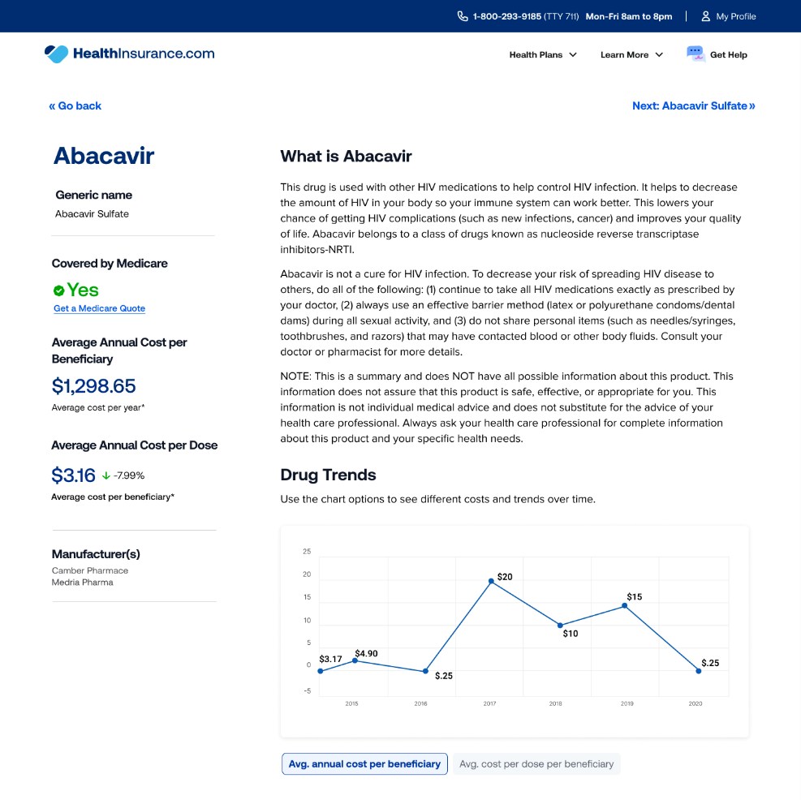
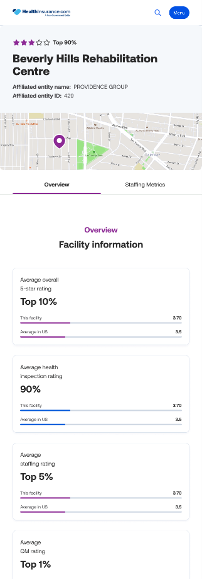
Notes:
Medicare Advantage and short-term insurance marketplace ecommerce
Developed information centers.
“Expedia”/Kayak of insurance.

Slide 15
Problem statement
Selecting a Medicare Advantage plan is confusing and time-consuming
    Some zip codes have > 100 plans available
    Many plans have $0 monthly premium and become indistinguishable
    Confirming doctor and drug coverage requires research
    By definition, >99% of potential customers are over 65 years old
How might we help customers confidently choose the right plan themselves?
Notes:
This story does not have a happy ending…
We’re trying to be the “Expedia of Medicare advantage” but it’s not as simple as “price, timing, layovers”
Note: Visual design is geared towards this target audience: straightforward, high-contrast, large type. DESKTOP

Slide 16
Factors
Business Impetus:
A closed sale via call center took nearly 30 minutes
Time on site after reaching plans was usually under 60 seconds
Over 90% of ‘high-intent’ online shoppers transition to call center
Call center employee model doesn’t scale well
Customer insights:
Tremendous anxiety exists about picking the wrong plan
People have low opinions of health insurance
People have difficulty predicting their usage
Notes:
Insurance is partially about peace of mind, feeling of picking the “wrong” plan undermines that.

Slide 17
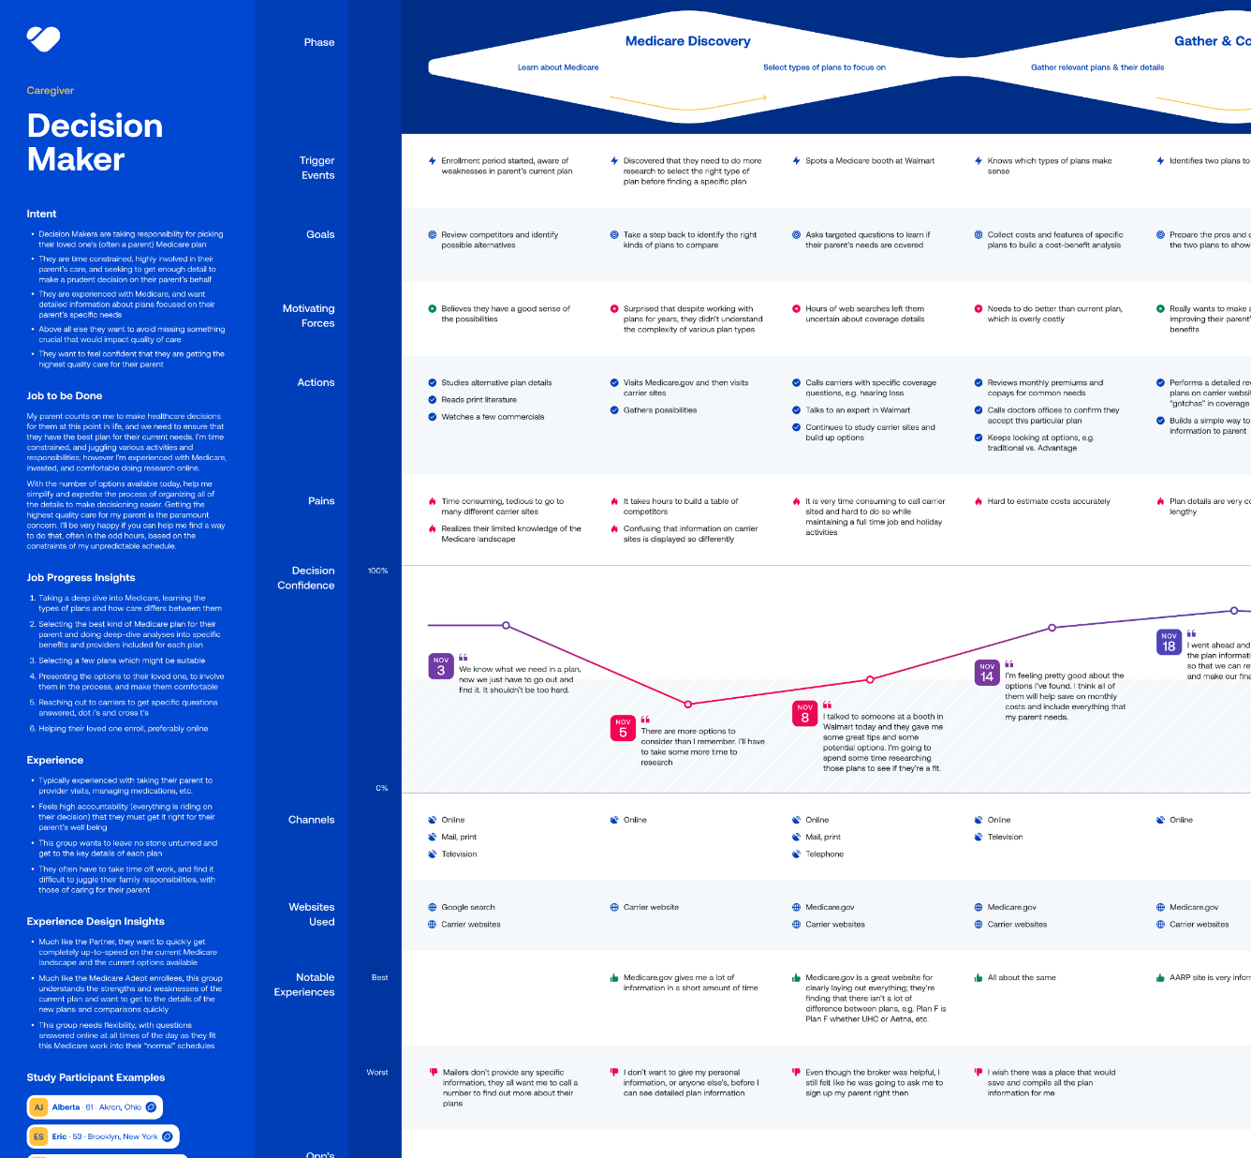
We interviewed potential customers and plotted their purchase experience to find opportunities

Slide 18
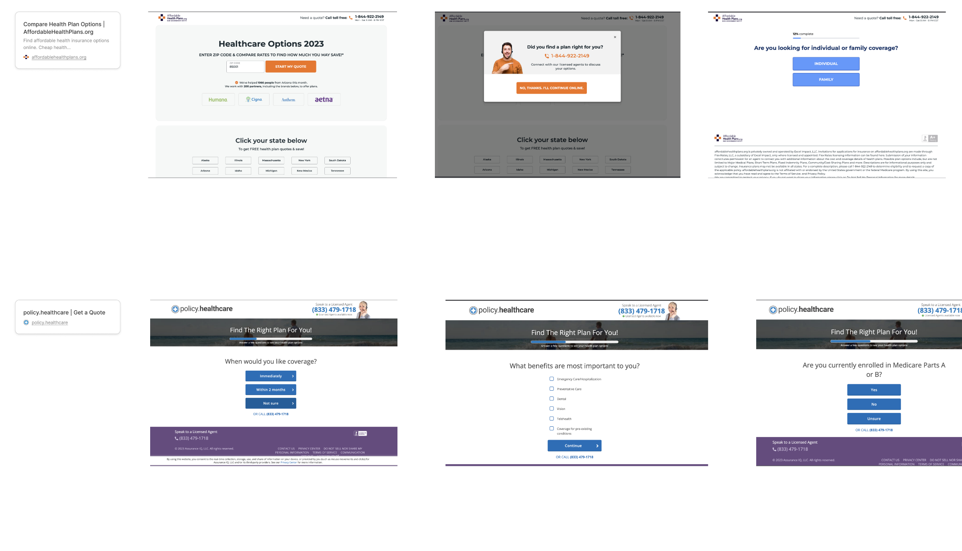
We performed competitive research to find strengths and weaknesses in the marketplace

Slide 19
We mapped the results of competitor landscape

Slide 20

We interviewed 10 seniors and 5 caregivers
and began a Dovetail library
AI-generated image. Not actual participants

Slide 21
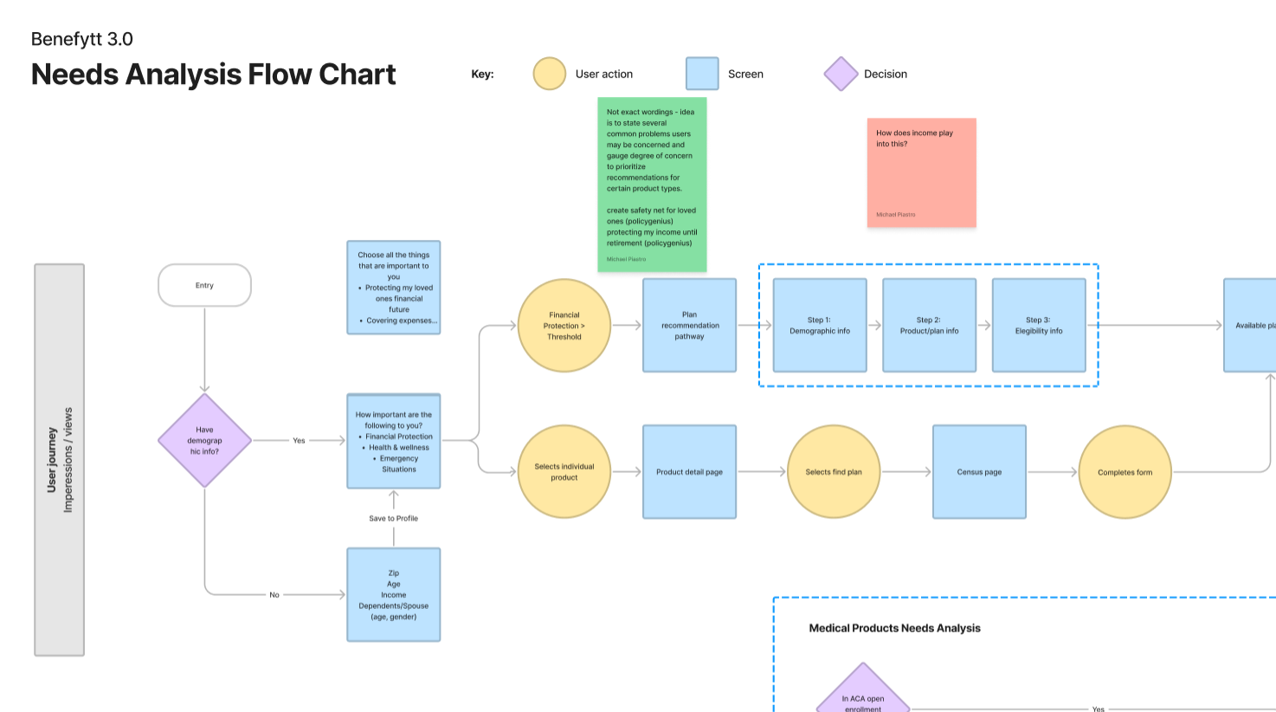
We mapped out the kind of questions that needed to be answered

Slide 22
Challenge #1
Tension between getting information and asking too many questions
More demographic information helps us serve and recommend better
More information requested means higher dropoff
Fewer, denser pages vs. many single-question pages
Notes:
Everyone has an opinion on the many questions per page vs many pages per question. Solution is A/B testing the various

Slide 23
Challenge #2
People have suspicions about providing information
Afraid to be sold
Trained by other sites: at the end of the funnel, they become a lead, not a result
They want a general sense of pricing before investing much time
Notes:
Insurance is partially about piece of mind, feeling of picking the “wrong” plan undermines that.

Slide 24
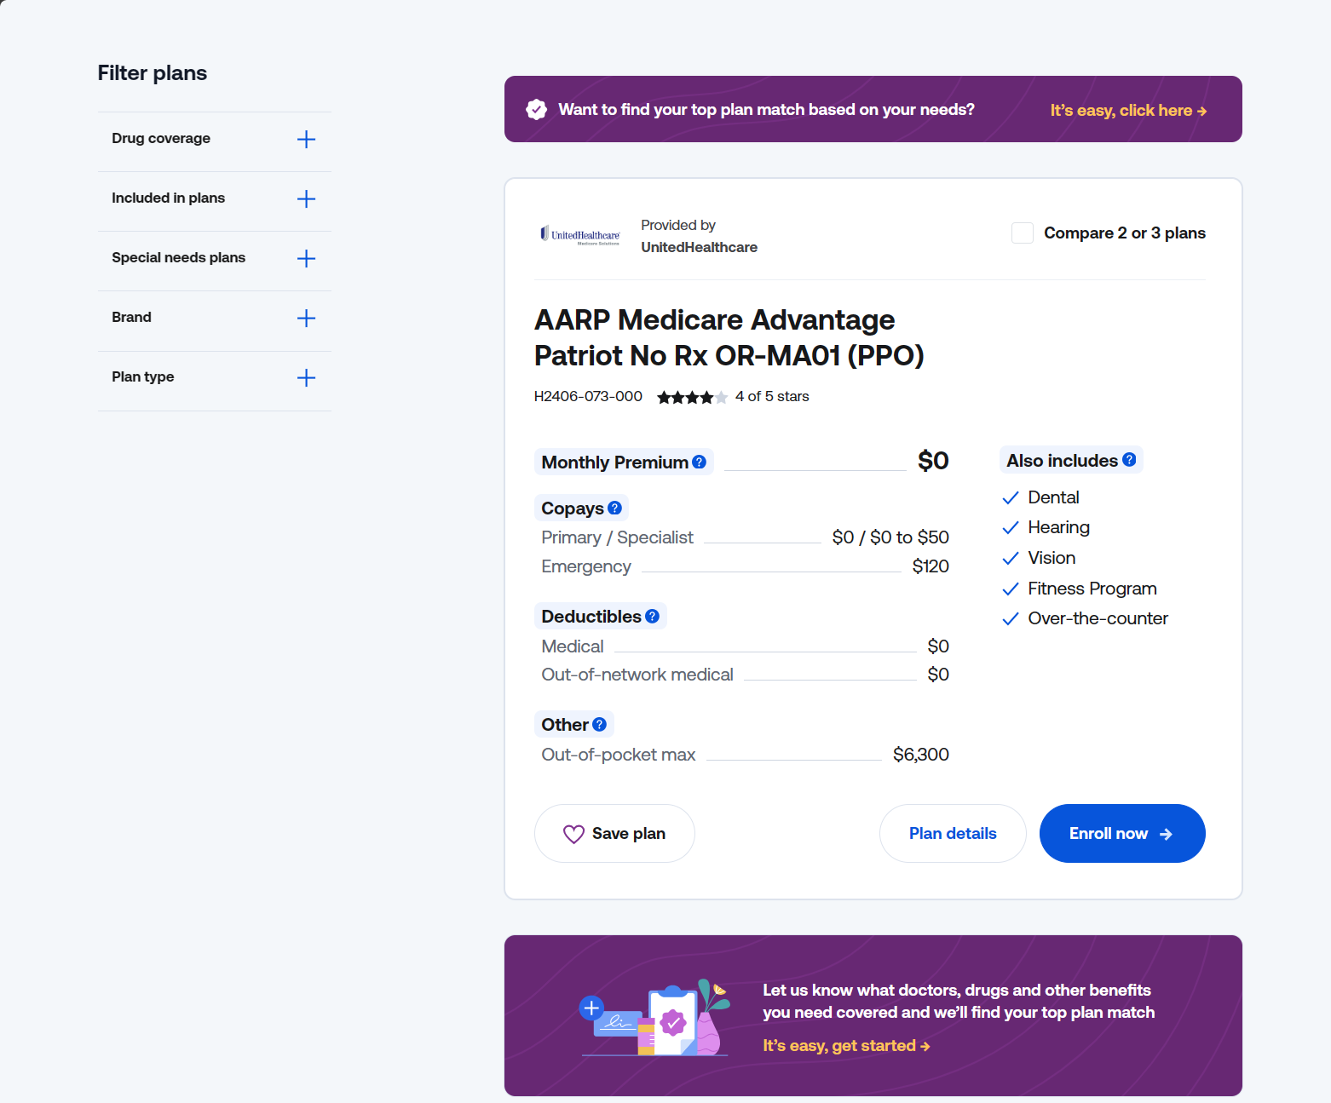
Notes:
Our solution here was allow people to skip to the plans and then inline with the plan results, have frequent invitations to provide more information for a recommendation.

Slide 25
Challenge #3
Two very different customer profiles
Seniors buying for themselves vs. their adult children
Opposite appetites for phone conversations
Opposite appetites for online sales
Potentially different knowledge sets (e.g. health history)
Notes:
Most said they would be doing this on desktop, target demo 35+

Slide 26
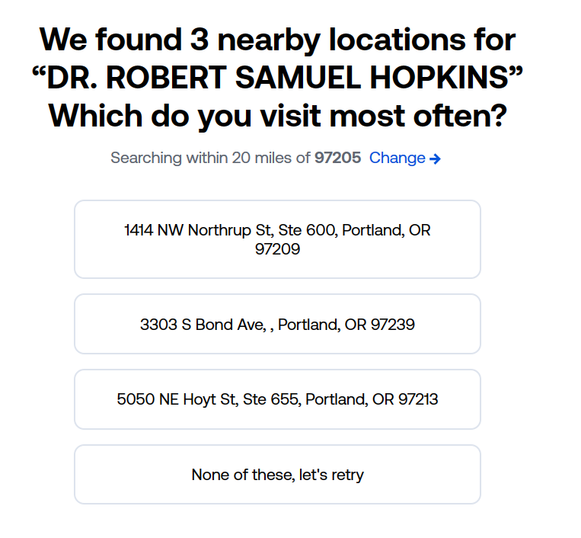
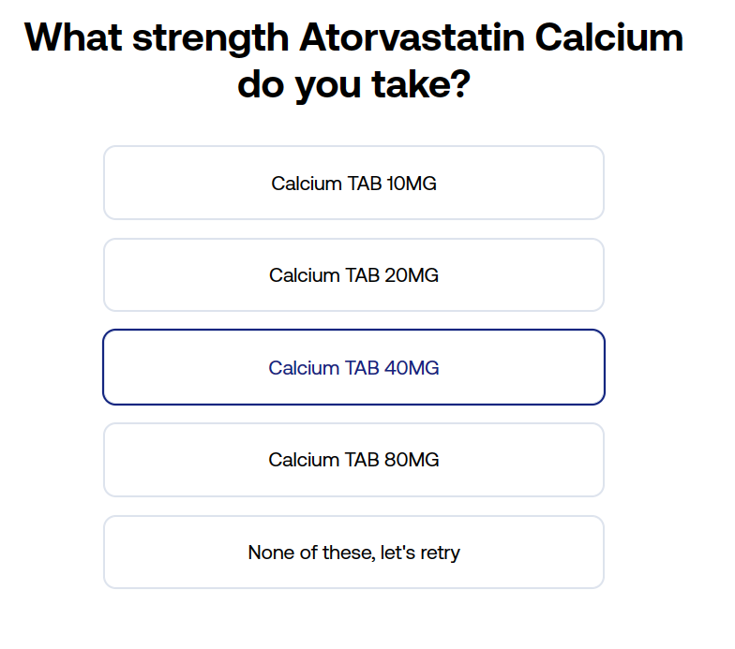
Challenge #4
Data structure and specificity
Drugs easily misspelled, exact names forgotten
Drug database needs dosage, quantity per container, and refill rate for estimates
Doctor database must have location to determine coverage
Pharmacy database may require branch (i.e. which CVS)

Slide 27
Success Metrics
Increase conversion rate online
Online shoppers transition to call center later in customer journey
Percentage who select “No, I’ll browse all plans myself”
Percentage who later add information after seeing plans
A/B/C testing of
    Going straight to plans
    Shortened survey
    Longer survey
Notes:
In some cases, esp. with lead capture shorter isn’t always better: lead quality, sense of investment

Slide 28
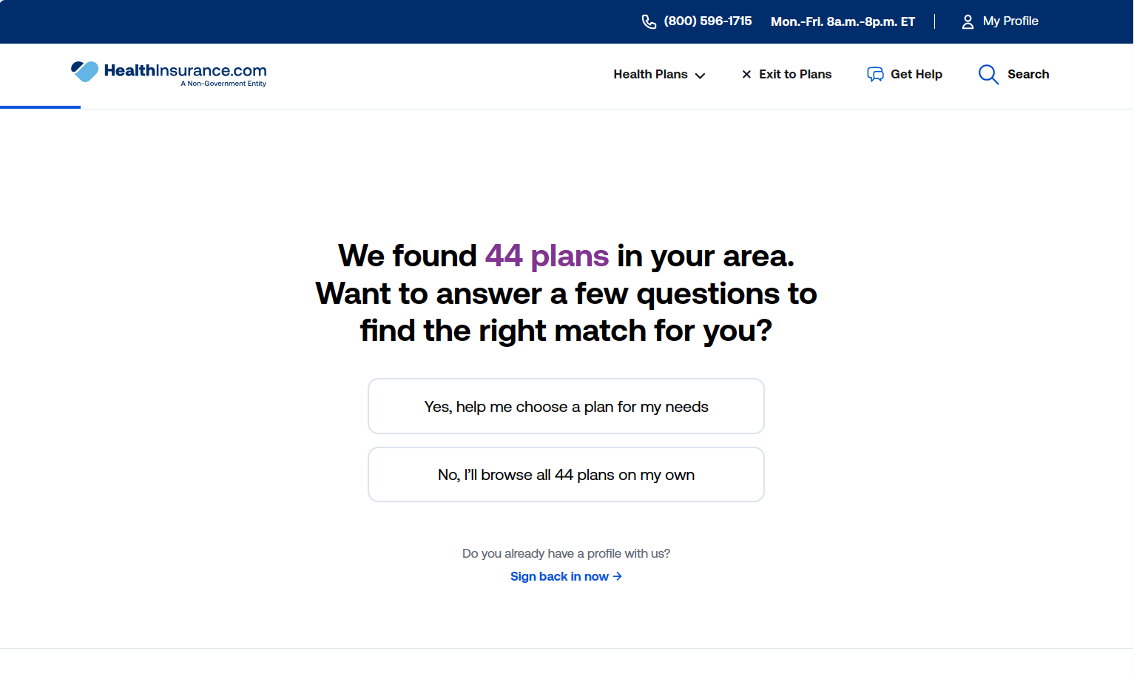

Slide 29
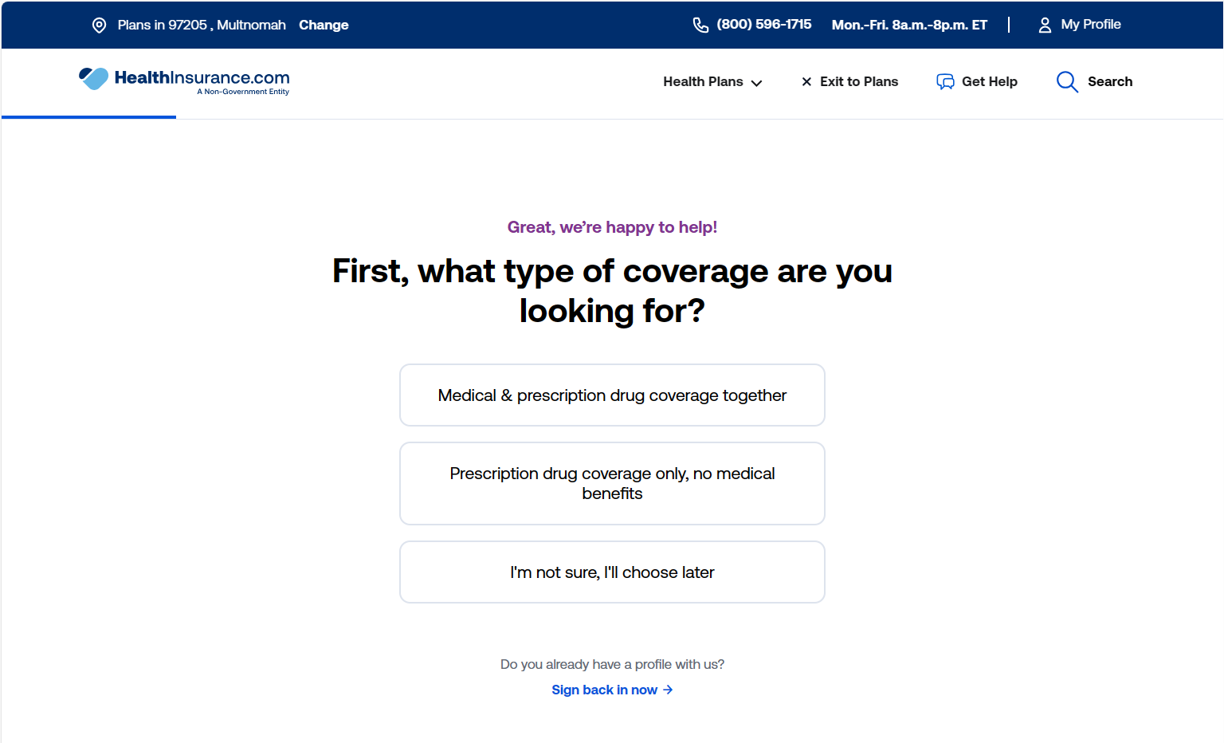
Notes:
Allow for confusion

Slide 30
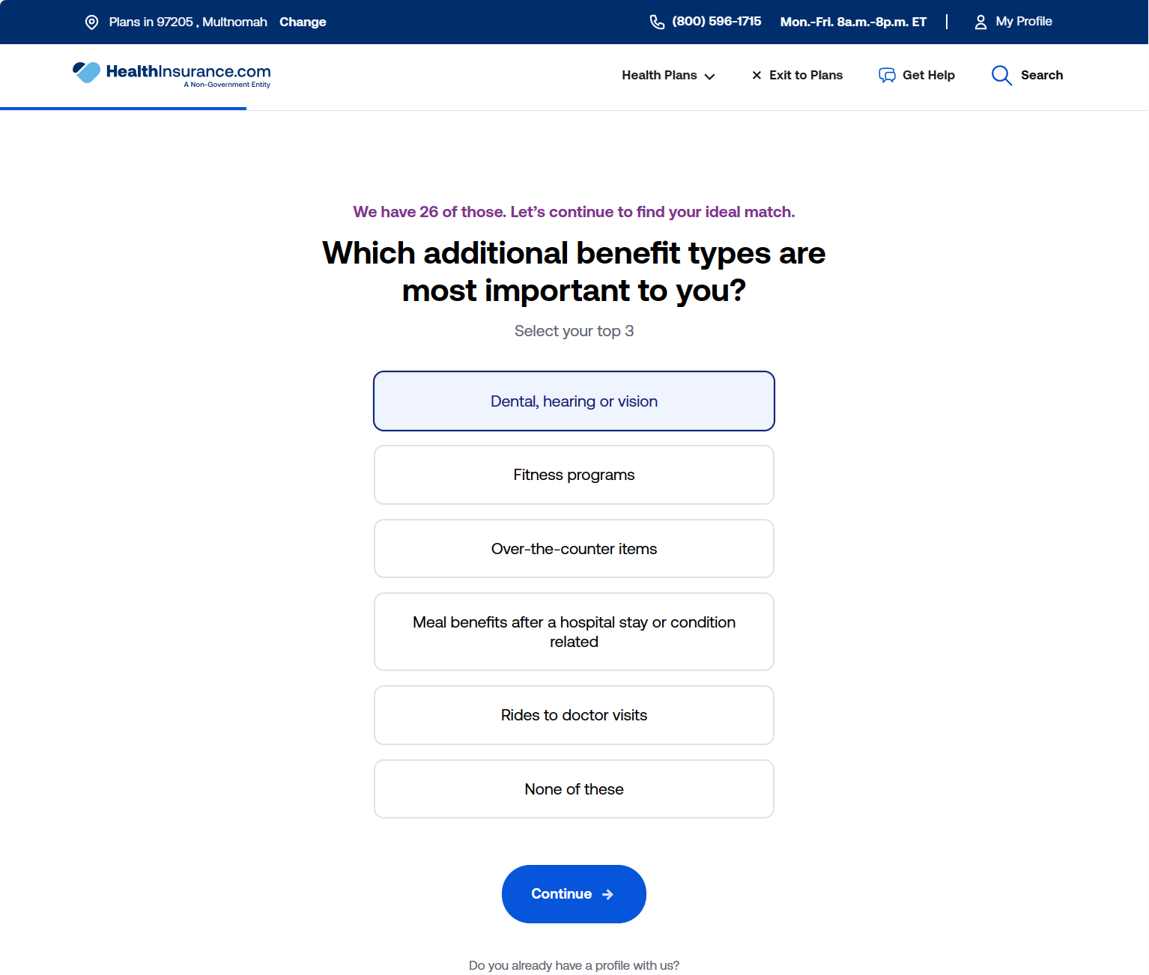

Slide 31
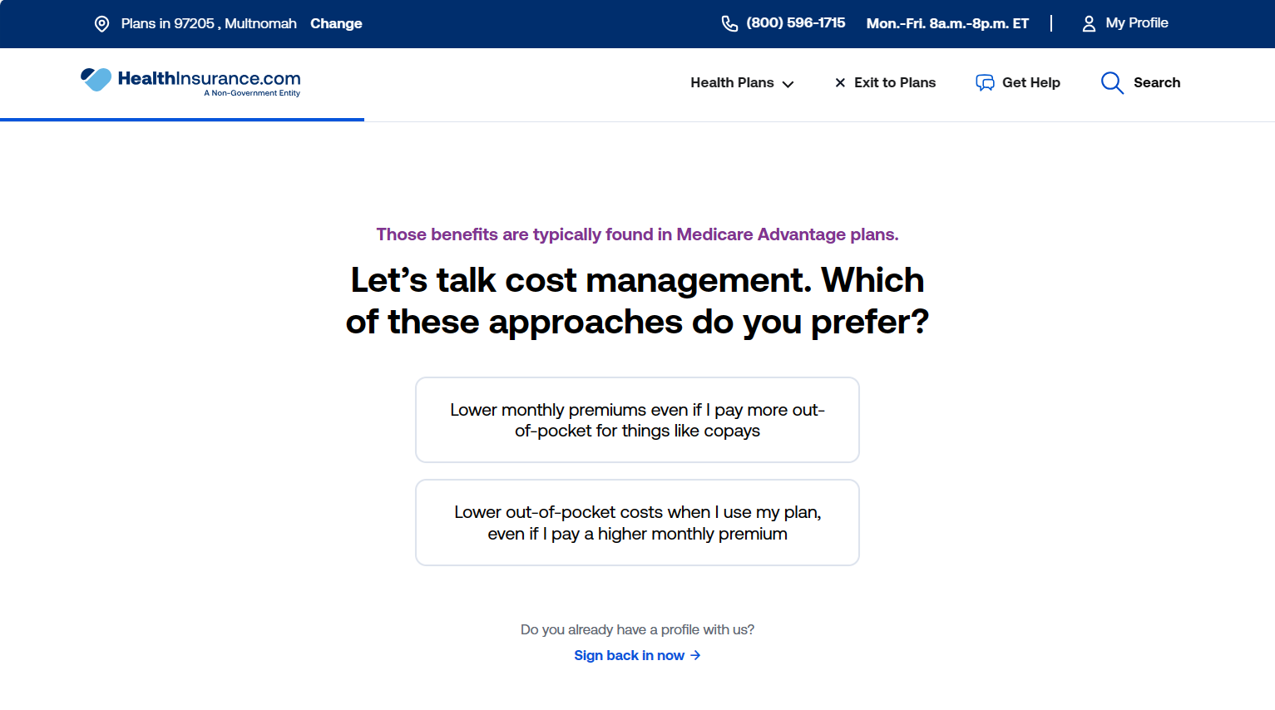

Slide 32
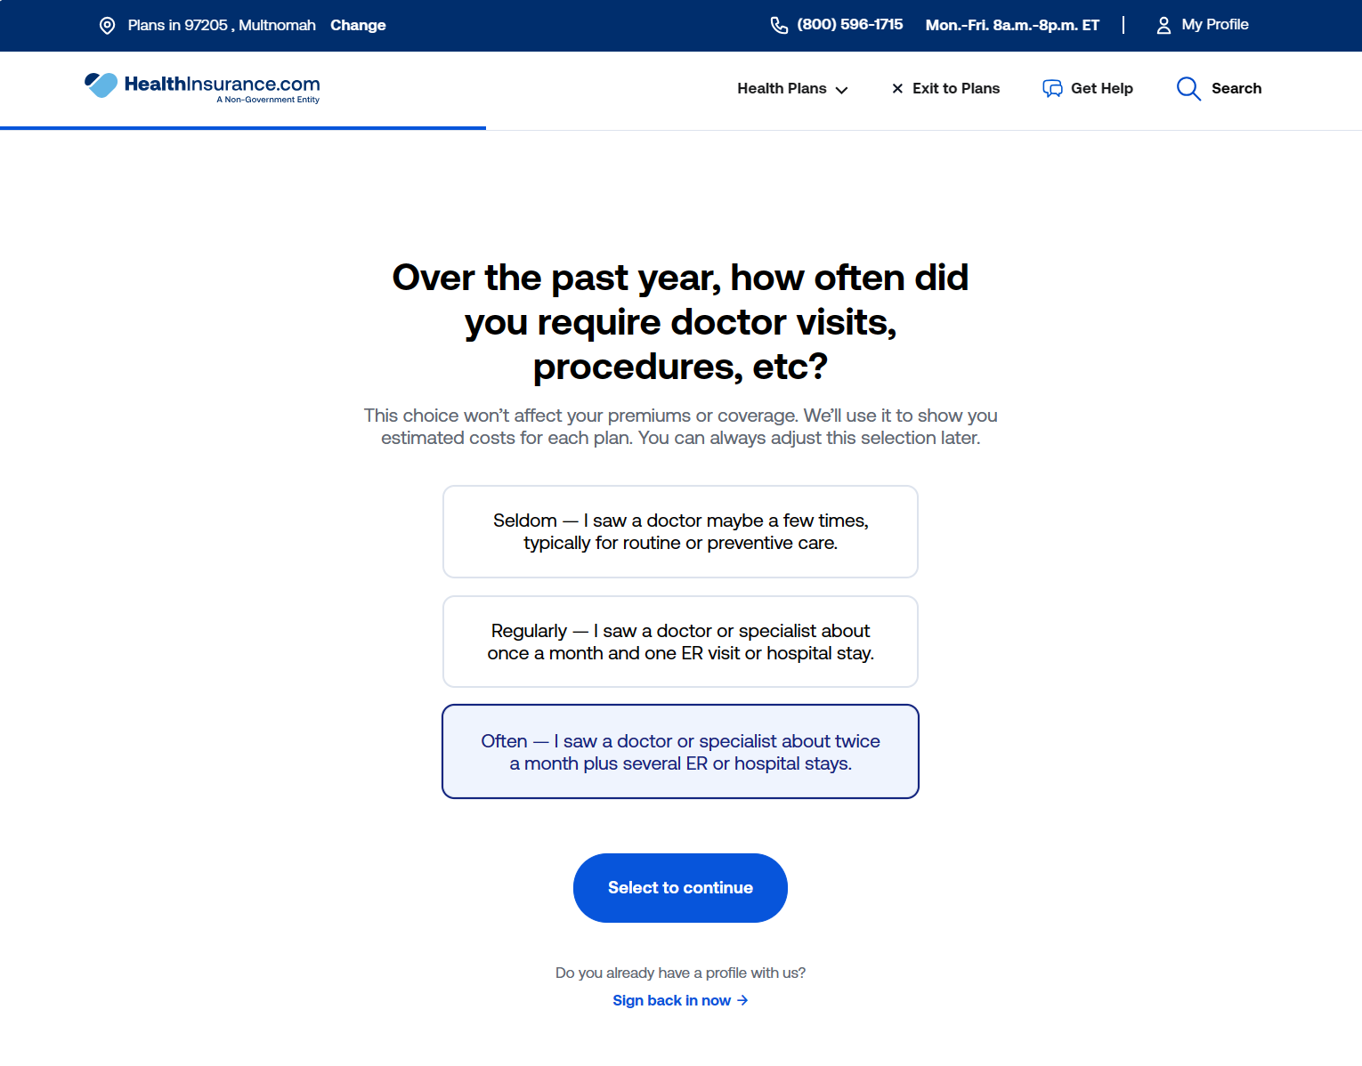

Slide 33
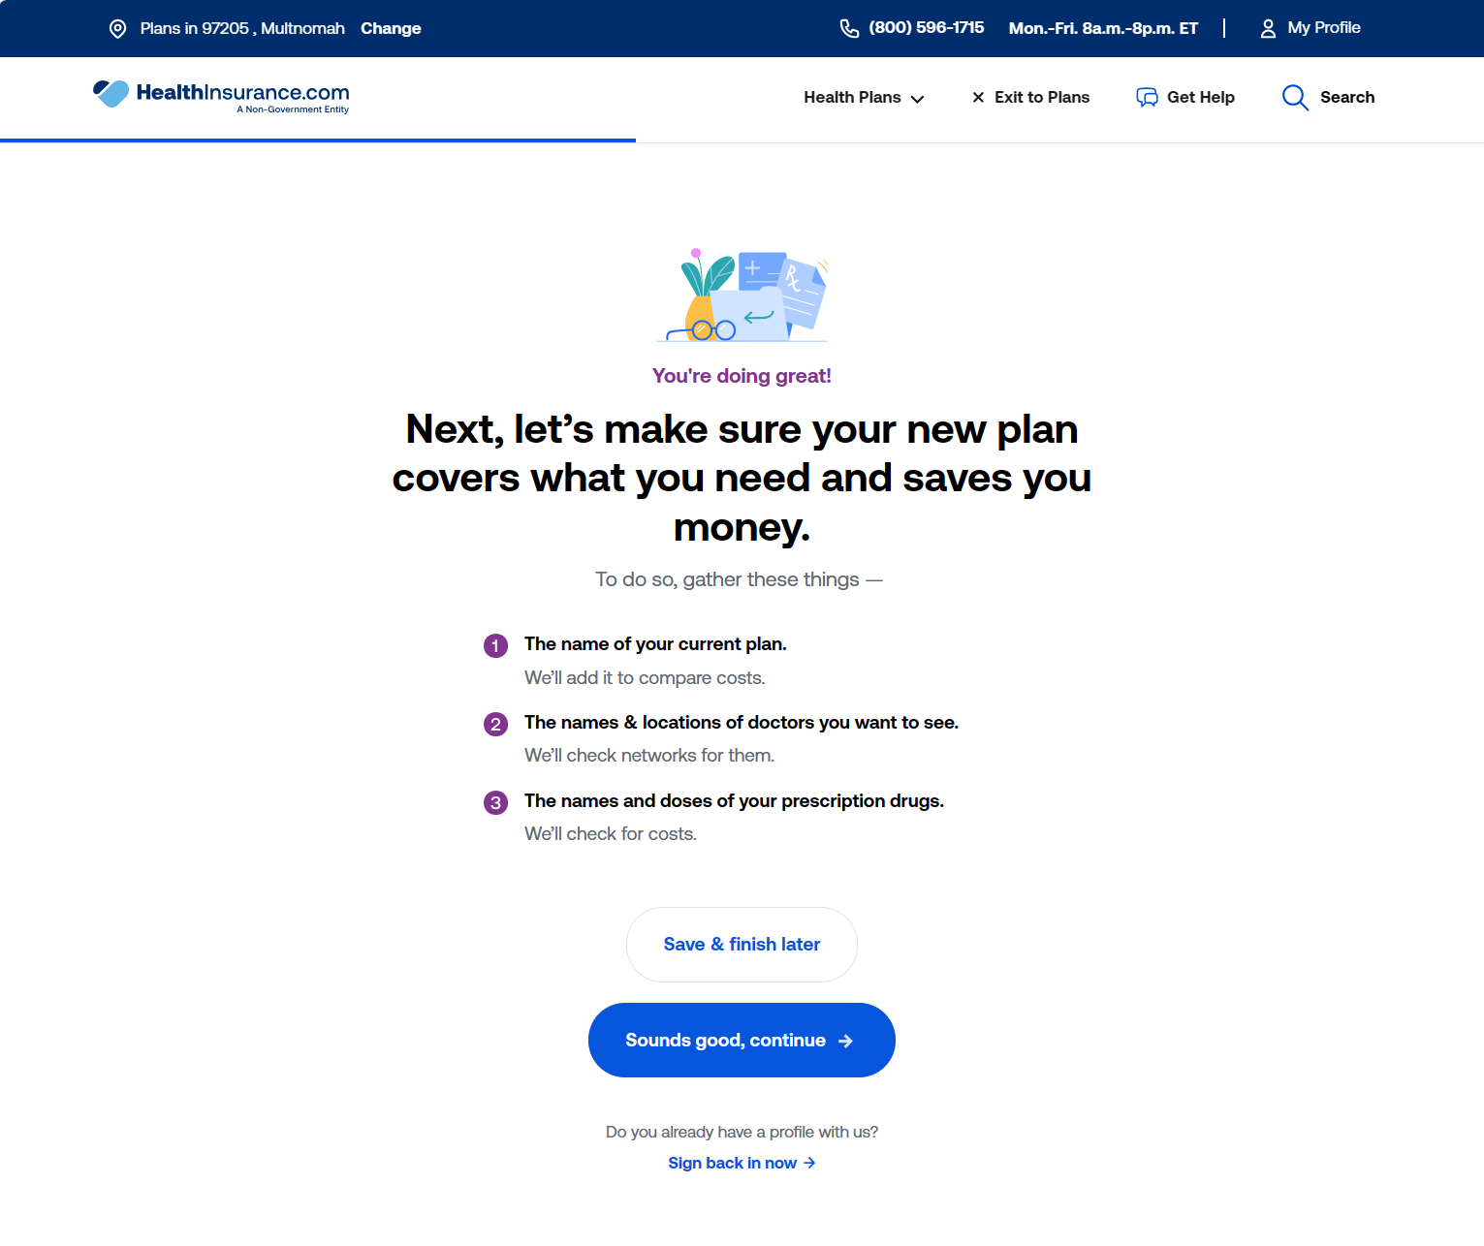

Slide 34
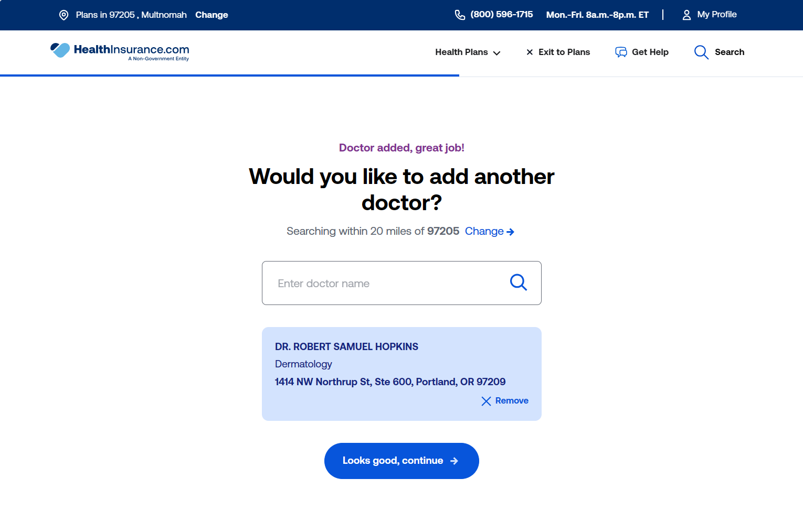

Slide 35
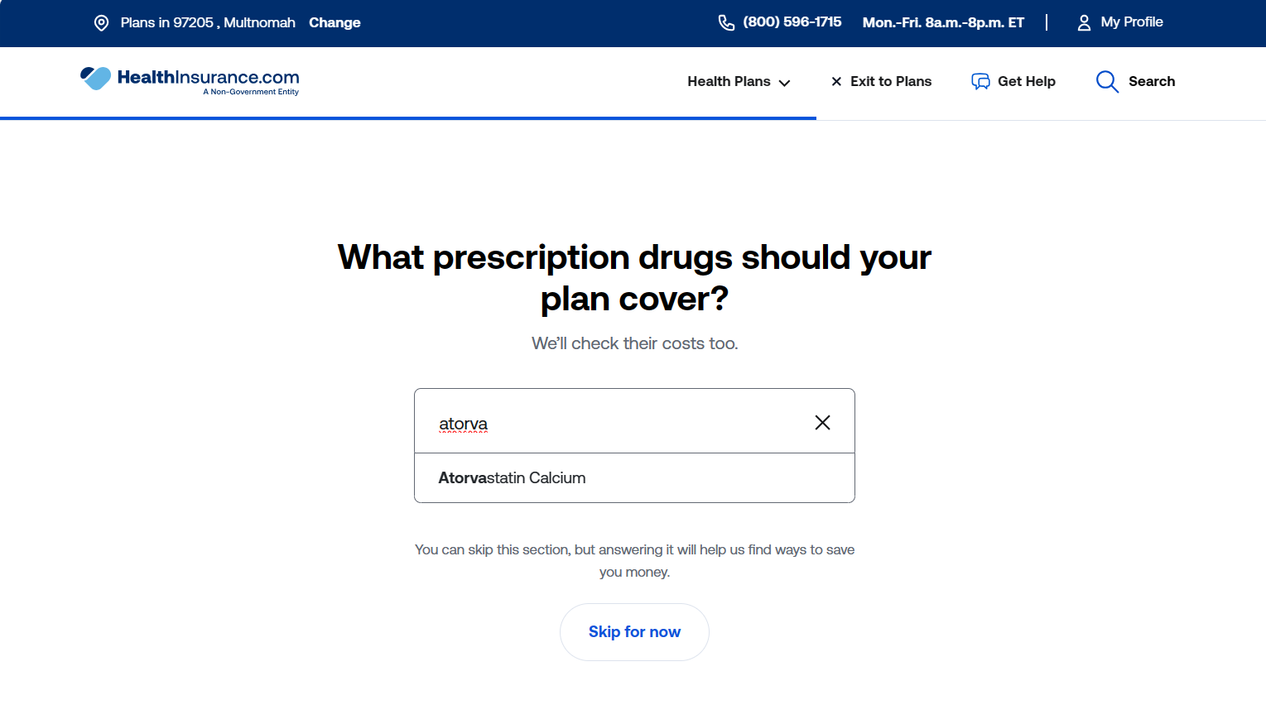

Slide 36
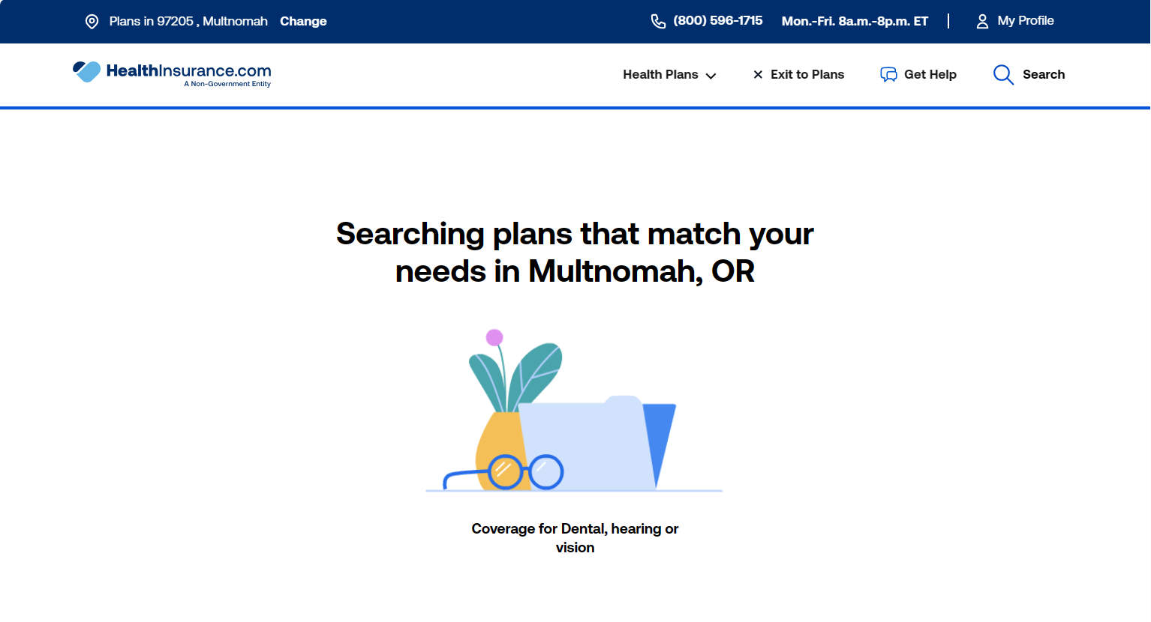

Slide 37
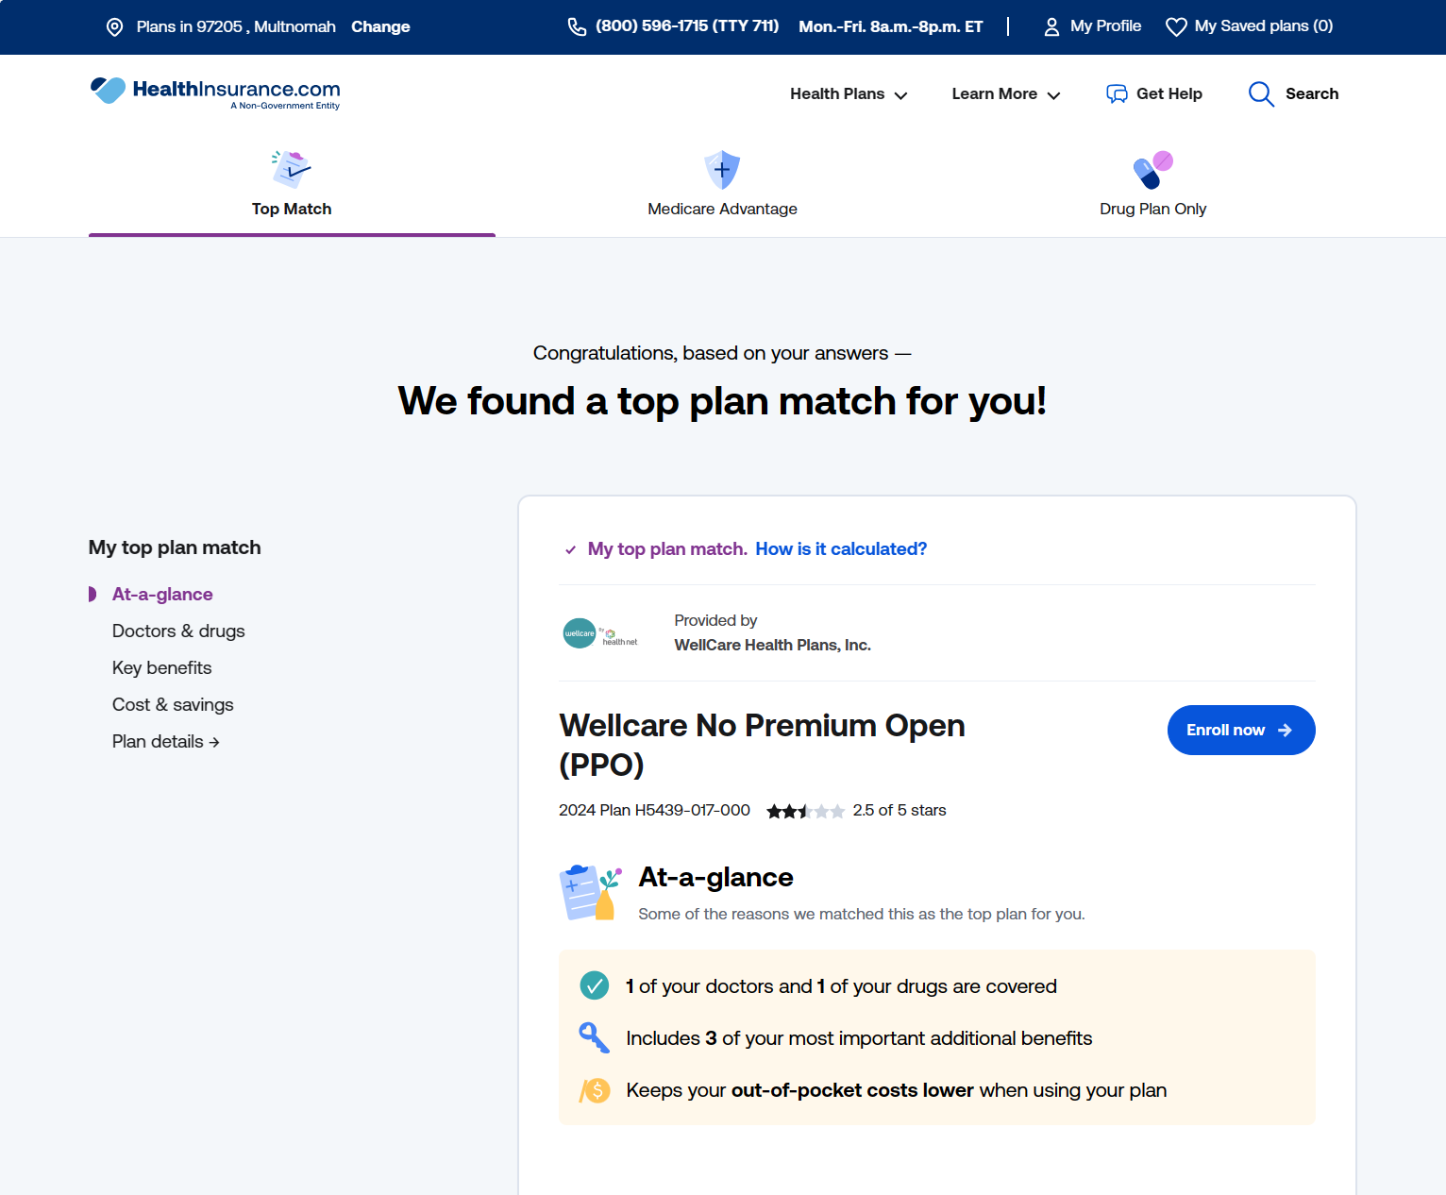

Slide 38
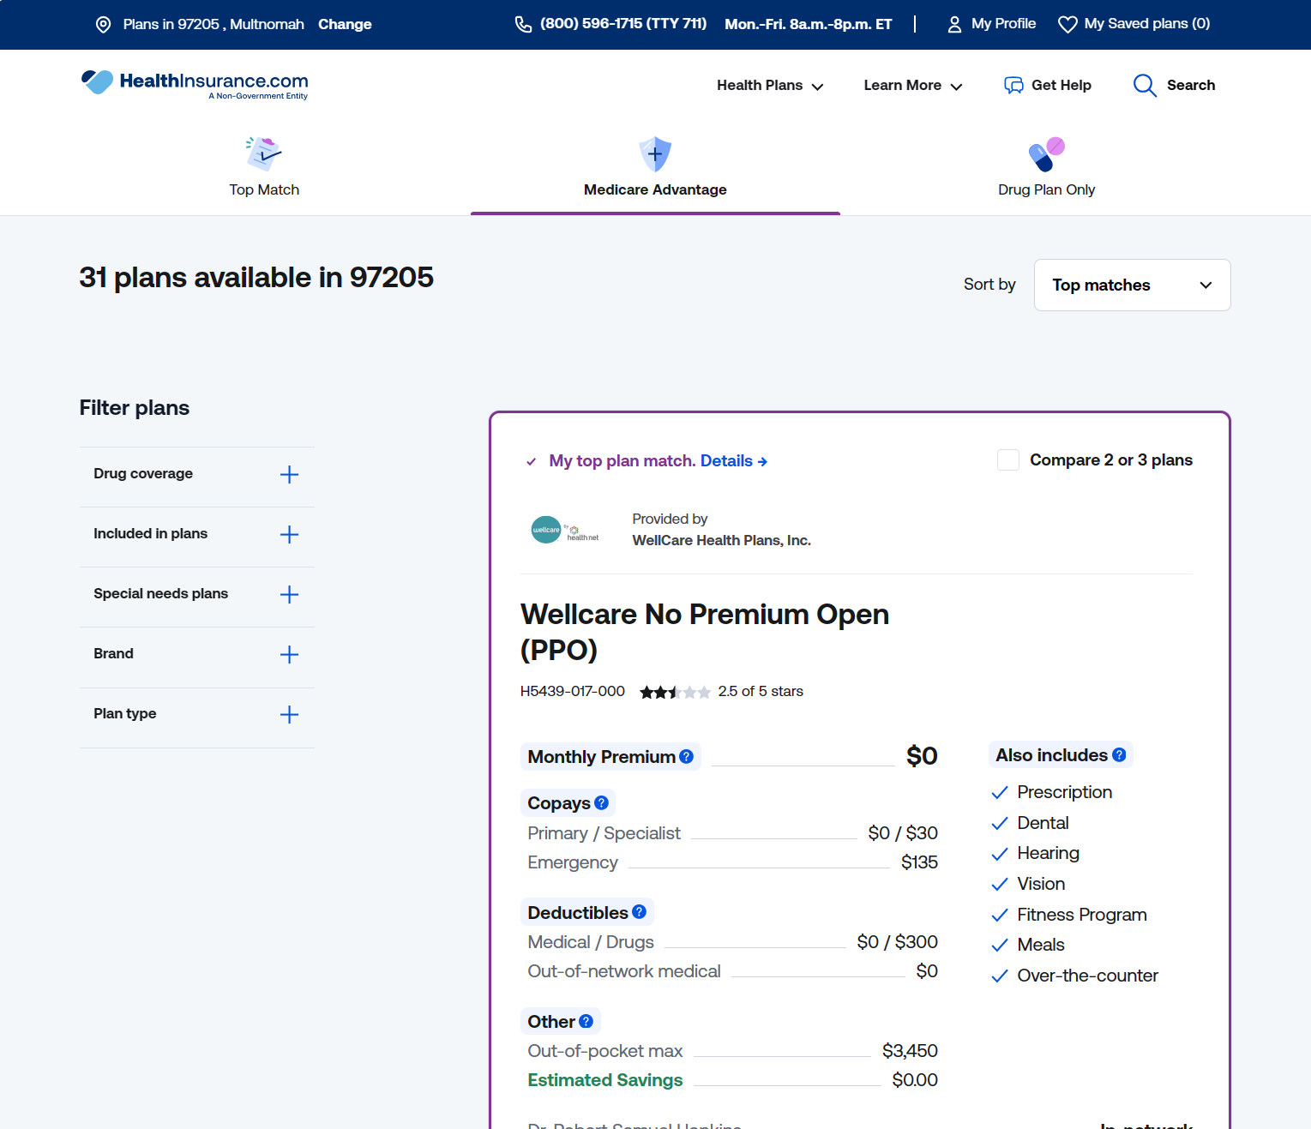

Slide 39
The Simple Truth
“Laziness” prevails: customers reliably choose the shortest path, even into sub-optimal solutions
Conversion rate was doubled in the “direct to plans” variant
Under 4% engaged with the Plan Recommendation tool vs. nearly 15% with the “comparison tray”
Short vs. long questionnaire A/B test showed no statistically significant difference
Corrections:
Default to showing plans immediately; gather information in smaller bites
Organize information in a non-linear way
Try to engage people within the tools they use most: “comparison tray,” product filters
Notes:
The information gathering was always developed as a flowchart, which, boxed us into a “wizard” like modality

Slide 40
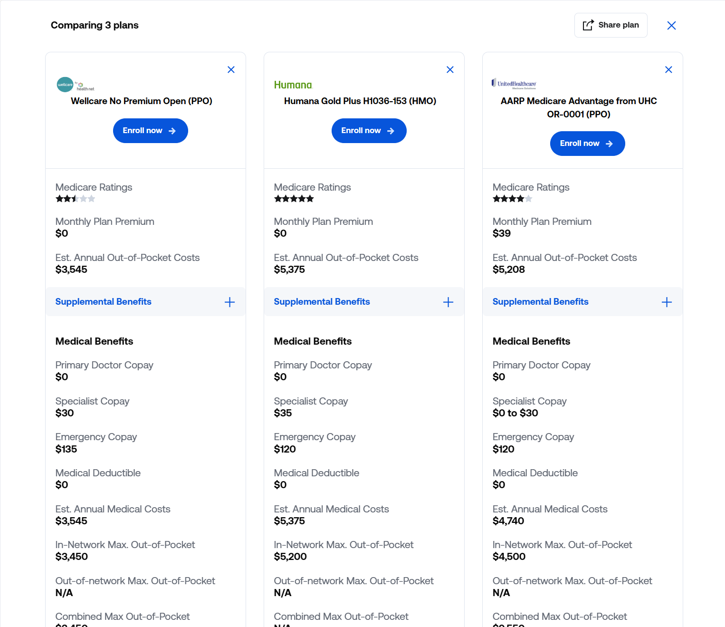

Slide 41
Beginly Health
Jobs Display Page

Slide 42
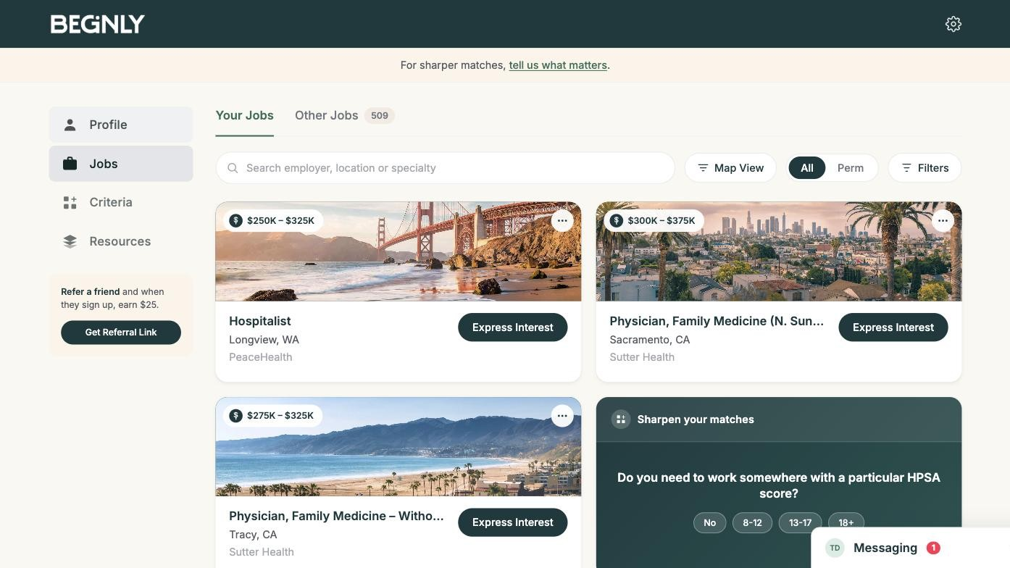
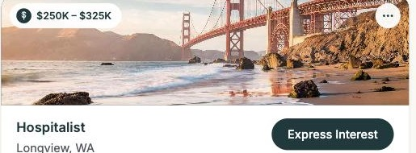
Beginly is a platform where paying clients (Employers) find highly qualified, motivated Physicians for tough-to-fill job opportunities. Physicians come to the platform

Slide 43
Problem Statement
LuckyOrange session data showed strong traffic but weak follow-through
    Physicians browsed listings but rarely used Express Interest, meaning employers didn’t get connected with candidates
    Physicians, who are bombarded with spam solicitors and protective of admitting they’re looking for work, didn’t trust
    Session recordings showed hesitation right at the moment of action
How might we turn browsing jobs into action?

Slide 44
Factors
What we had to work with
    LuckyOrange heatmaps and session recordings across the jobs display page
    Claude Code for AI-iterative design, testing layout and flow changes
    Zero resources for in-person user testing before launch
    An existing design system and component library from the broader Beginly Health product
Customer Insights
    The world of Physician recruitment is completely flipped from tech; highly coveted candidates for too many jobs
    Providers get texts from random recruiters multiple times daily
    Tight knit specialty communities talk often, so as soon as a Provider asks questions, their community knows

Slide 45
Challenge #1
Express Interest needed to feel low-commitment and immediate
    Simplified the interaction from a multi-field ask into a single clear action
    Used Claude Code to test copy and placement variants directly against real session replays

Slide 46
Success Metrics
Engagement
    Express Interest click-through rate
    Job saves per session, tracked in employer dashboard
    Scroll depth and time on the jobs display page

Slide 47
Results
[Add final results once available]
    [Express Interest engagement lift]
    [Onboarding completion lift]
    [Job save rate lift]
Lesson: Iterating directly against real session data — not intuition alone — turns UI that "looks fine" into UI that actually converts
    [Add supporting detail once results are finalized]

Slide 48
Thank you

